Slide 1

X EDUCATION -LEAD SCOREING CASE STUDY
By Arnab Patra

Slide 2
Table of Contents
Background of X Education Company
Problem Statement & Objective of the Study
Suggested Ideas for Lead Conversion
Analysis Approach
Data Cleaning
EDA
Data Preparation
Model Building (RFE & Manual ﬁne tuning)
Model Evaluation
Recommendations

Slide 3
Background of X Education Company
An education company named X Education sells online courses to industry professionals.
On any given day, many professionals who are interested in the courses land on their website and browse for courses.
The company markets its courses on several websites and search engines like Google.
Once these people land on the website, they might browse the courses or ﬁll up a form for the course or watch some videos.
When these people ﬁll up a form providing their email address or phone number, they are classiﬁed to be a lead.
Once these leads are acquired, employees from the sales team start making calls, writing emails, etc.
Through this process, some of the leads get converted while most do not.
The typical lead conversion rate at X education is around 30%.

Slide 4
Problem Statement & Objective of the Study
Problem Statement:
X Education gets a lot of leads, its lead conversion rate is very poor at around 30%
X Education wants to make lead conversion process more efﬁcient by identifying the most potential leads, also known as Hot Leads
Their sales team want to know these potential set of leads, which they will be focusing more on communicating rather than making calls to everyone.
Objective of the Study:
To help X Education select the most promising leads, i.e., the leads that are most likely to convert into paying customers.
The company requires us to build a model wherein we need to assign a lead score to each of the leads such that the customers with a higher lead score have a higher conversion chance and the customers with a lower lead score have a lower conversion chance.
The CEO has given a ballpark of the target lead conversion rate to be around 80%.

Slide 5








Suggested Ideas for Lead Conversion
Leads Grouping
Better Communication
Boost Conversion
Leads are grouped based on their propensity or likelihood to convert.
This results in a focused group of hot leads.
We could have a smaller pool of leads to communicate with, which would allow us to have a greater impact.
We would have a greater conversion rate and be able to hit the 80% objective since we concentrated on hot leads that were more likely to convert.
Since we have a target of 80% conversion rate, we would want to obtain a high sensitivity in obtaining hot leads.

Slide 6







Analysis Approach
Model Building:
RFE for top 15 feature, Manual Feature Reduction & finalizing model
Model Evaluation:
Confusion matrix, Cutoff Selection, assigning Lead Score
Predictions on Test Data:
Compare train vs test metrics, Assign Lead Score and get top features
Recommendation:
Suggest top 3 features to focus for higher conversion & areas for improvement
Data Cleaning:
Loading Data Set, understanding & cleaning data
EDA:
Check imbalance, Univariate & Bivariate analysis
Data Preparation
Dummy variables, test-train split, feature scaling

Slide 7
Data Cleaning
"Select" level represents null values for some categorical variables, as customers did not choose any option from the list.
Columns with over 40% null values were dropped.
Missing values in categorical columns were handled based on value counts and certain considerations.
Drop columns that don't add any insight or value to the study objective (tags, country)
Imputation was used for some categorical variables.
Additional categories were created for some variables.
Columns with no use for modeling (Prospect ID, Lead Number) or only one category of response were dropped.
Numerical data was imputed with mode after checking distribution.

Slide 8
Data Cleaning
Skewed category columns were checked and dropped to avoid bias in logistic regression models.
Outliers in TotalVisits and Page Views Per Visit were treated and capped.
Invalid values were ﬁxed and data was standardized in some columns, such as lead source.
Low frequency values were grouped together to “Others”.
Binary categorical variables were mapped.
Other cleaning activities were performed to ensure data quality and accuracy.
Fixed Invalid values & Standardizing Data in columns by checking casing styles, etc. (lead source has Google, google)

Slide 9
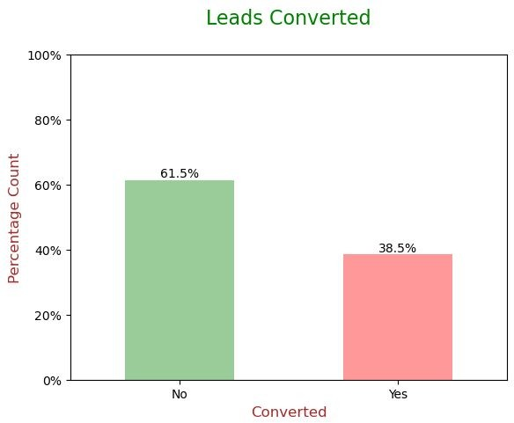
EDA
Data is imbalanced while analyzing target variable.
Conversion rate is of 38.5%, meaning only 38.5% of the people have converted to leads.(Minority)
While 61.5% of the people didn't convert to leads. (Majority)

Slide 10
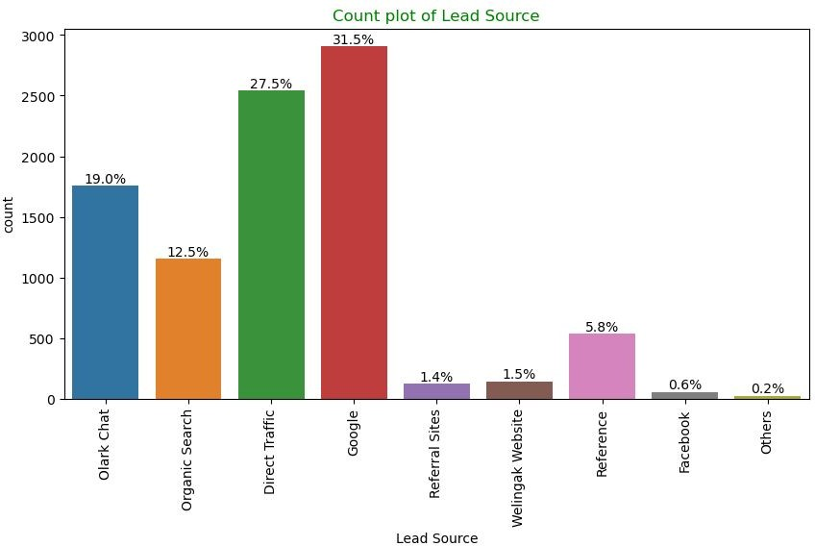
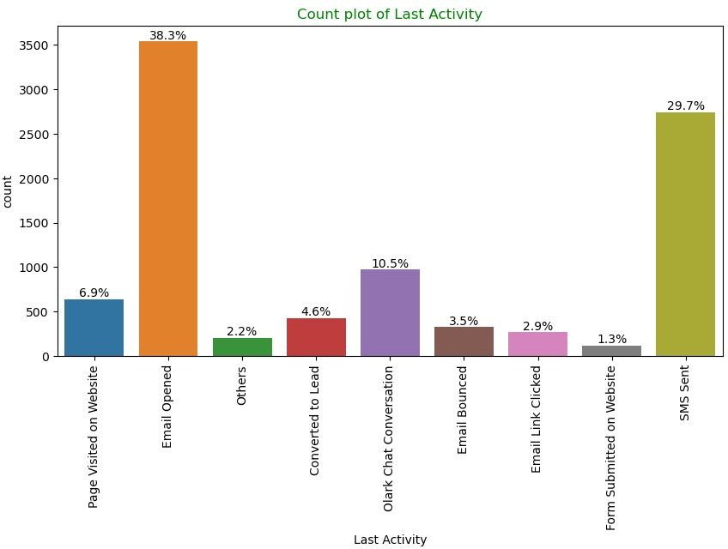
EDA
Univariate Analysis – Categorical Variables
Lead Source: 58% Lead source is from Google & Direct Trafﬁc combined.
Last Activity: 68% of customers contribution in SMS Sent & Email Opened activities.

Slide 11
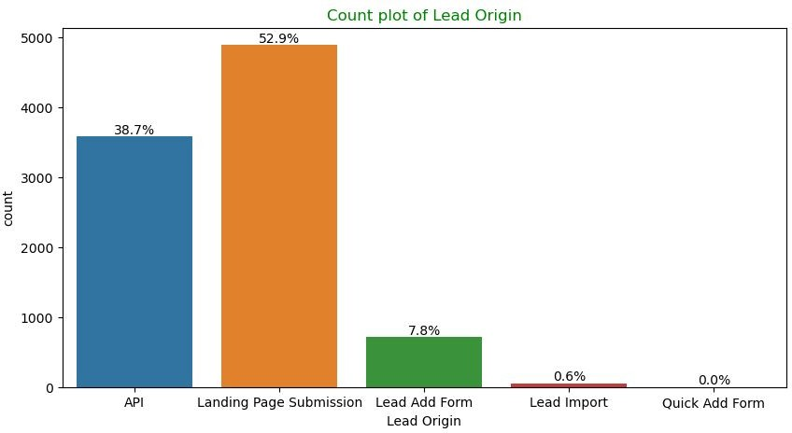
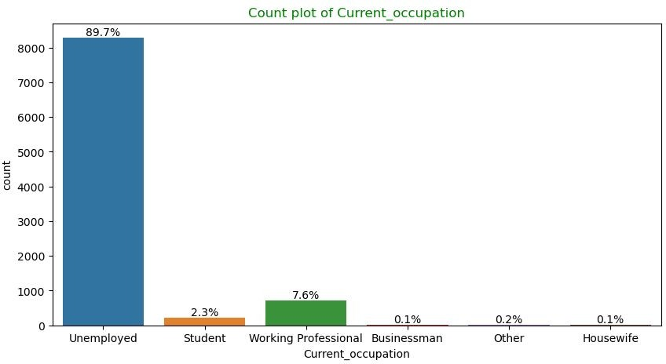
EDA
Univariate Analysis – Categorical Variables
Lead Origin: "Landing Page Submission" identiﬁed 53% of customers, "API" identiﬁed 39%.
Current_occupation: It has 90% of the customers as Unemployed.

Slide 12
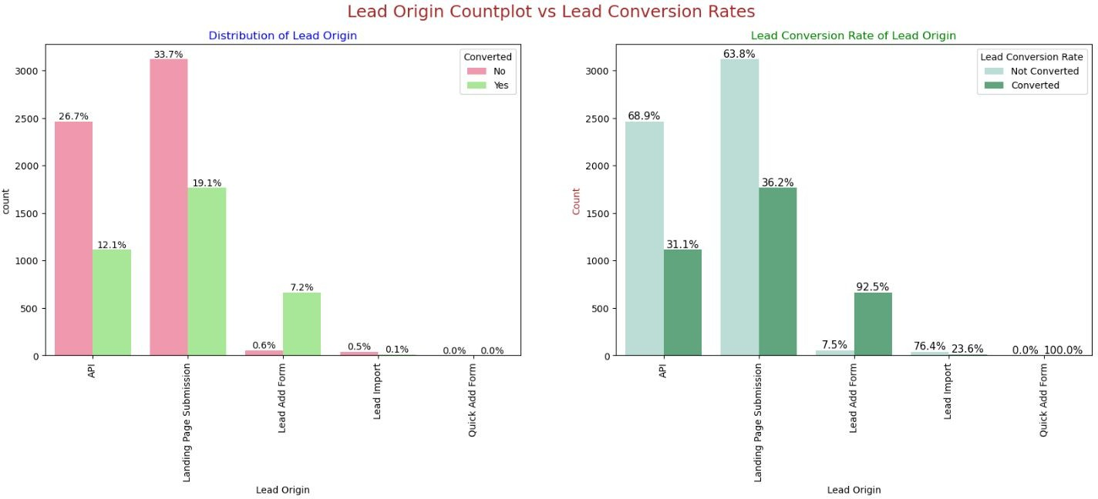
EDA – Bivariate Analysis for Categorical Variables
Lead Origin:
Around 52% of all leads originated from "Landing Page Submission" with a lead conversion rate (LCR) of 36%.
The "API" identiﬁed approximately 39% of customers with a lead conversion rate (LCR) of 31%.
12

Slide 13
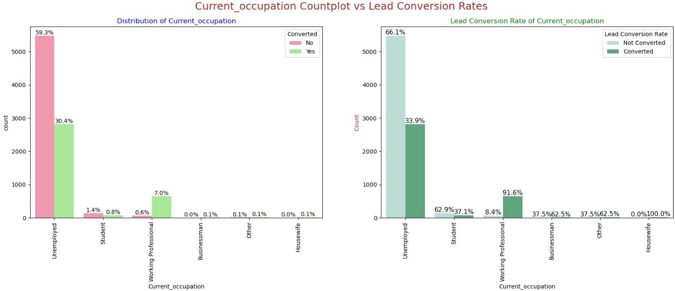
EDA – Bivariate Analysis for Categorical Variables
Current_occupation:
Around 90% of the customers are Unemployed, with lead conversion rate (LCR) of 34%.
While Working Professional contribute only 7.6% of total customers with almost 92% Lead conversion rate (LCR).
13

Slide 14
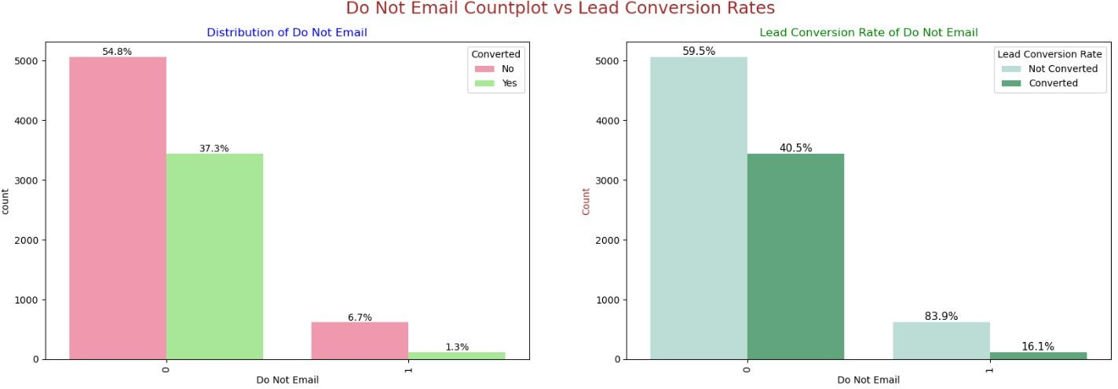
EDA – Bivariate Analysis for Categorical Variables
Do Not Email:
92% of the people has opted that they don't want to be emailed about the course & 40% of them are converted to leads.
14

Slide 15
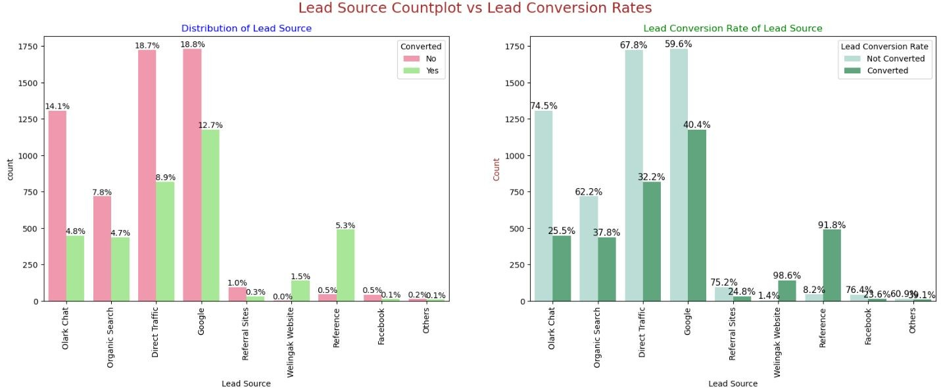
EDA – Bivariate Analysis for Categorical Variables
Lead Source:
●
●
●
●
Google
has LCR of 40% out of 31% customers,
Direct Traffic
contributes 32% LCR with 27% customers, which is lower than Google,
Organic Search
also gives 37.8% of LCR, but the contribution is by only 12.5% of customers,
Reference
has LCR of 91%, but there are only around 6% of customers through this Lead Source.
15

Slide 16
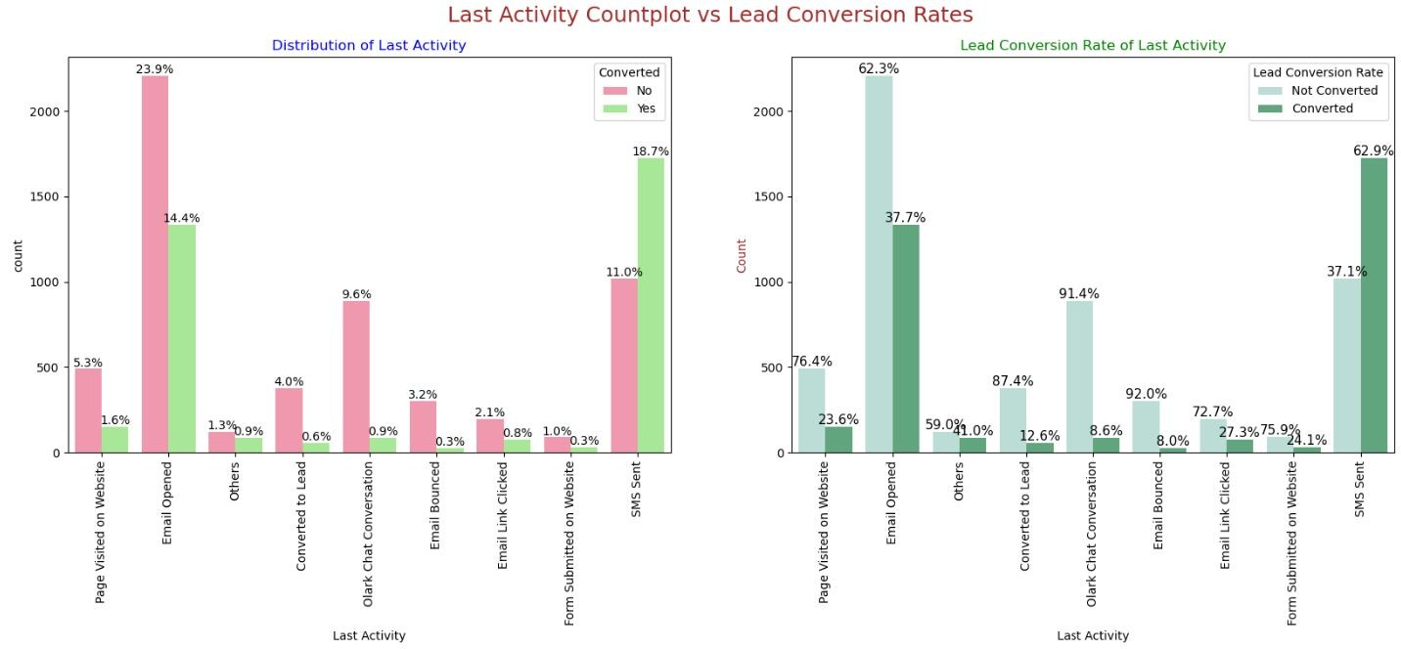
EDA – Bivariate Analysis for Categorical Variables
Last Activity:
'
SMS Sent'
has high lead conversion rate of 63% with 30% contribution from last activities,
'
Email Opened'
activity contributed 38% of last activities performed by the customers, with 37% lead
conversion rate.
16

Slide 17
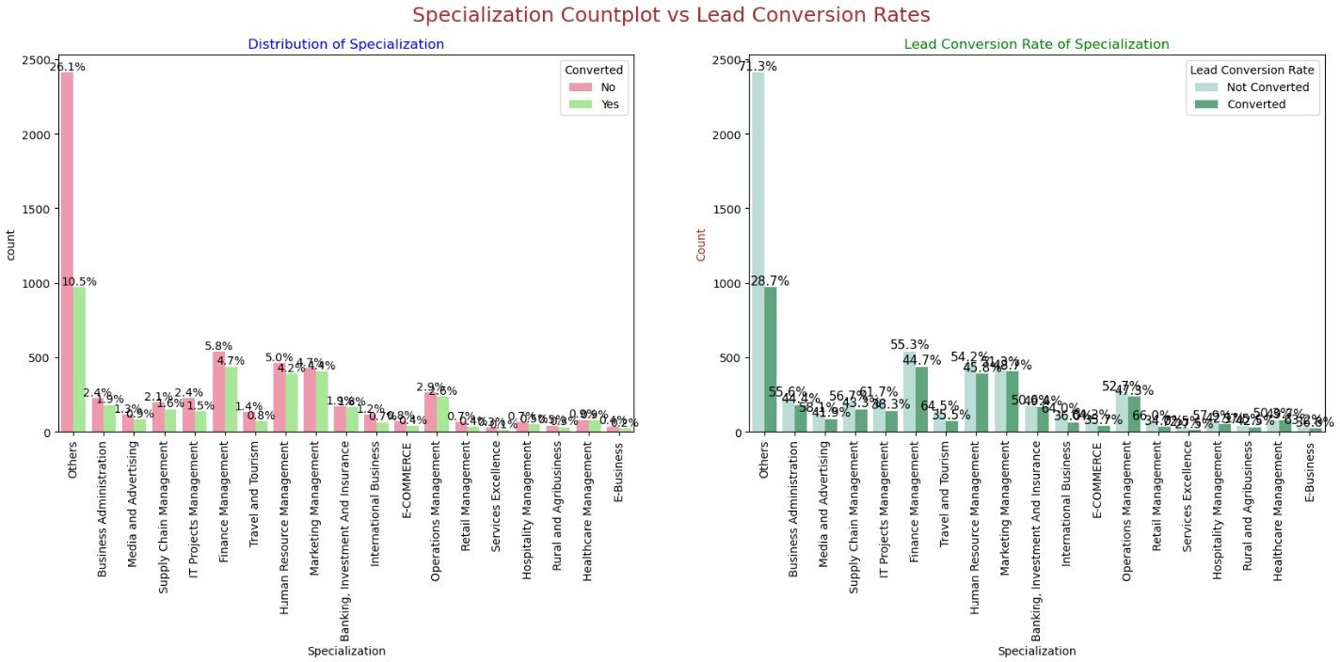
EDA – Bivariate Analysis for Categorical Variables
Specialization:
Marketing Management, HR Management, Finance Management shows good contribution in Leads conversion than other specialization.
17

Slide 18
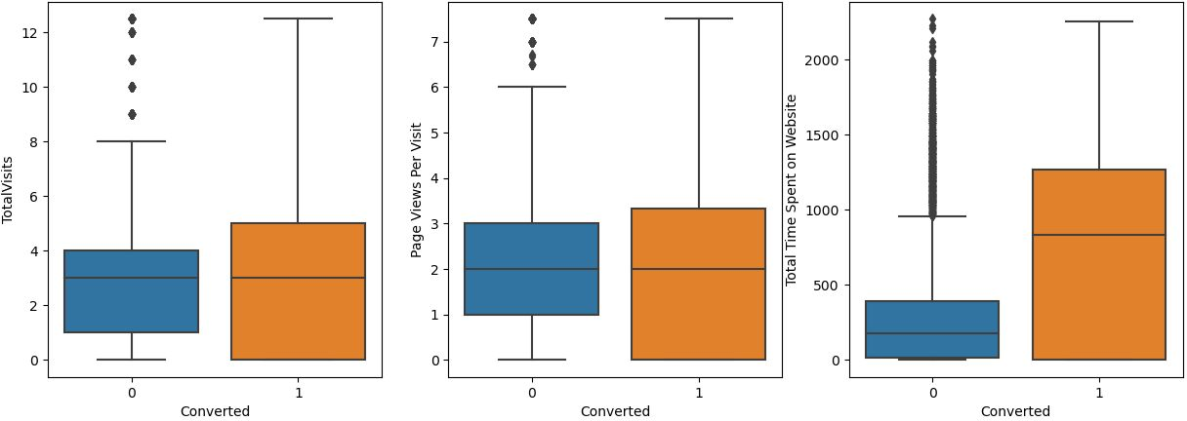
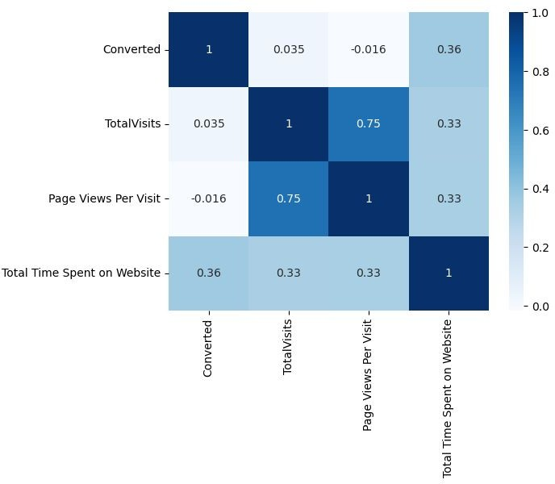
EDA – Bivariate Analysis for Numerical Variables
Past Leads who spends more time on the Website have a higher chance of getting successfully converted than those who spends less time as seen in the box-plot

Slide 19
Data Preparation before Model building
Binary level categorical columns were already mapped to 1 / 0 in previous steps
Created dummy features (one-hot encoded) for categorical variables – Lead Origin, Lead Source, Last Activity, Specialization, Current_occupation
Splitting Train & Test Sets
70:30 % ratio was chosen for the split
Feature scaling
Standardization method was used to scale the features
Checking the correlations
Predictor variables which were highly correlated with each other were dropped (Lead Origin_Lead Import and Lead Origin_Lead Add Form).

Slide 20
Model Building
Feature Selection
The data set has lots of dimension and large number of features.
This will reduce model performance and might take high computation time.
Hence it is important to perform Recursive Feature Elimination (RFE) and to select only the important columns.
Then we can manually ﬁne tune the model.
RFE outcome
Pre RFE – 48 columns & Post RFE – 15 columns

Slide 21
Model Building
Manual Feature Reduction process was used to build models by dropping variables with p – value greater than 0.05.
Model 4 looks stable after four iteration with:
signiﬁcant p-values within the threshold (p-values < 0.05) and
No sign of multicollinearity with VIFs less than 5
Hence, logm4 will be our ﬁnal model, and we will use it for Model Evaluation which further will be used to make predictions.

Slide 22
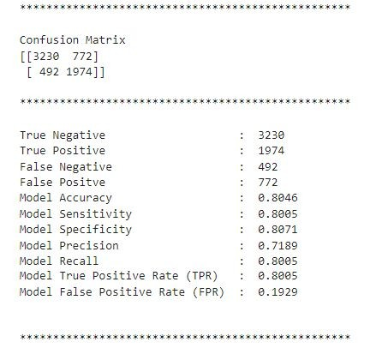
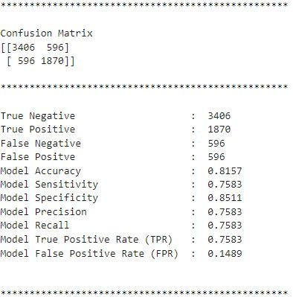
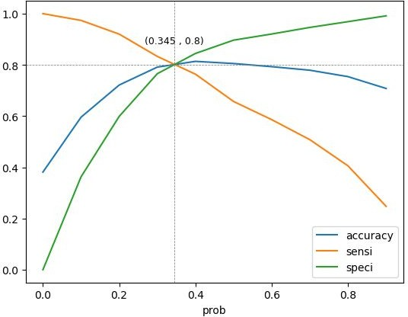
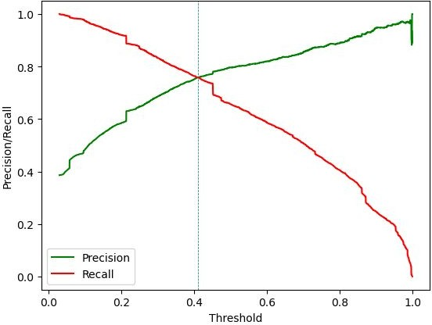
Model Evaluation
Train Data Set
Confusion Matrix & Evaluation Metrics with 0.345 as cutoff
Confusion Matrix & Evaluation Metrics with 0.41 as cutoff
It was decided to go ahead with 0.345 as cutoff after checking evaluation metrics coming from both plots

Slide 23
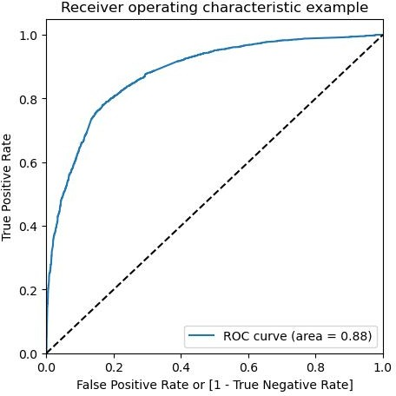

Model Evaluation
ROC Curve – Train Data Set
Area under ROC curve is 0.88 out of 1 which indicates a good predictive model.
The curve is as close to the top left corner of the plot, which represents a model that has a high true positive rate and a low false positive rate at all threshold values.
ROC Curve – Test Data Set
Area under ROC curve is 0.87 out of 1 which indicates a good predictive model.
The curve is as close to the top left corner of the plot, which represents a model that has a high true positive rate and a low false positive rate at all threshold values.

Slide 24
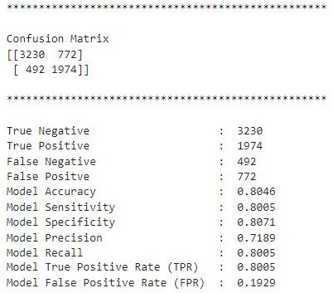
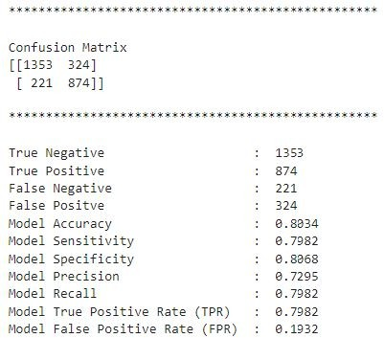
Model Evaluation
Confusion Matrix & Metrics
Train Data Set
Test Data Set
Using a cut-off value of 0.345, the model achieved a sensitivity of 80.05% in the train set and 79.82% in the test set.
Sensitivity in this case indicates how many leads the model identify correctly out of all potential leads which are converting
The CEO of X Education had set a target sensitivity of around 80%.
The model also achieved an accuracy of 80.46%, which is in line with the study's objectives.
24

Slide 25
Recommendation based on Final Model
As per the problem statement, increasing lead conversion is crucial for the growth and success of X Education. To achieve this, we have developed a regression model that can help us identify the most signiﬁcant factors that impact lead conversion.
We have determined the following features that have the highest positive coefﬁcients, and these features should be given priority in our marketing and sales efforts to increase lead conversion.
Lead Source_Welingak Website: 5.39
Lead Source_Reference: 2.93
Current_occupation_Working Professional: 2.67
Last Activity_SMS Sent: 2.05
Last Activity_Others: 1.25
Total Time Spent on Website: 1.05
Last Activity_Email Opened: 0.94
Lead Source_Olark Chat: 0.91
We have also identiﬁed features with negative coefﬁcients that may indicate potential areas for improvement. These include:
Specialization in Hospitality Management: -1.09
Specialization in Others: -1.20
Lead Origin of Landing Page Submission: -1.26

Slide 26
Recommendation based on Final Model
To increase our Lead Conversion Rates
Focus on features with positive coefﬁcients for targeted marketing strategies.
Develop strategies to attract high-quality leads from top-performing lead sources.
Optimize communication channels based on lead engagement impact.
Engage working professionals with tailored messaging.
More budget/spend can be done on Welingak Website in terms of advertising, etc.
Incentives/discounts for providing reference that convert to lead, encourage providing more references.
Working professionals to be aggressively targeted as they have high conversion rate and will have better ﬁnancial situation to pay higher fees too.
To identify areas of improvement
Analyze negative coefﬁcients in specialization offerings.
Review landing page submission process for areas of improvement.

